Slide 1
Advancing robotic surgery

Slide 2
Contents
Who We Are
What We Do
Comprehensive Assessments
Advanced Program Development
Precision Marketing
Conclusion

Slide 3
Who We Are
MIS specializes in surgical robotics consulting with a focus on cardiovascular and thoracic surgery at the strategic and clinical operations level
MIS utilizes business intelligence at the strategic and clinical operations levels for precision marketing strategies and clinical operations analysis
MIS is dedicated to providing proven solutions for building successful advanced robotic surgery programs.
35 years experience in minimally invasive surgery focusing on solution-based selling
11 years of robotic cardiovascular and thoracic surgery consultative experience
Veteran Owned Small Business
Notes:
Canada 1,100 hospitals 45 Billion in revenue……Currently 1100 robots worldwide
2/3 hospitals smaller than 100 beds…..Only approx 350 hospitals with greater than 100 beds

Slide 4
How do we develop successful Advanced Robotic Surgery programs?

Slide 5
Client Success Process
Comprehensive Assessments
Executive
Advanced Program Development
High Density Team Training
Precision Marketing
Business Intelligence
Market
Clinical
Advanced Clinical Support
Predictive Analytics
Internal
External
Program Optimization

Slide 6
Comprehensive Assessment
The assessment helps us determine the right program and price value for our clients.
Executive Assessment
Discover current strategic objectives and initiatives
Clinical Assessment
Discover current capabilities
Market Assessment
Internal Markets
External Markets
Target Markets

Slide 7
Executive Assessment
Interviews: C Level
(CEO, COO, CMO, CFO, CNO)
Interviews
IDN Affiliate, VP Marketing, VP Foundations, VP Surgeon Recruiting etc.
Pre-Assessment Guide

Slide 8
Clinical Assessment
Training Analysis
(Surgeon and team)
Initial Plan & Results
Procedure Volume Analysis by Specialty
Analysis of Past Procedures
Clinical Data Review
Clinical Pre-Assessment

Slide 9
Market Assessment Overview
External Market Assessment by City / Hospital: Procedures (CABG, MVR, AVR, Lobe Total CT)
Referral Profiles & Analysis
Client Percentage of Market
Projections: Hybrid Growth
External Market Assessment by City / Hospital: Revenue (CABG, MVR, AVR, Lobe Total CT)
KPI¹ Analytics (LOS², Blood Product Use etc.)
Market Assessment
Part 1: External
Market Assessment
Part 2: Internal
Projections: Procedures and Revenue Growth
¹: KPI – Key Performance Indicators
²: LOS – Length of Stay

Slide 10
CV Initiative Alignment with MIS
Client CV Initiative Alignment
After the assessment, we align our expertise to the client’s initiatives
This alignment ensures that our clients know we are focused on their objectives

Slide 11
Client – MIS Synchronization Matrix
Client CV Initiative | Robotic Application | MIS Expertise
Coronary Artery Disease (PCI incl. with hybrid procedure) | Robotic Hybrid Revascularization (Thoracotomy) Port-only Hybrid Revascularization | RHR TECAB (POHR)
Atrial Fibrillation | Arrested Heart MAZE Beating Heart MAZE | AH MAZE BH MAZE
Atrial Septal Defect Patent Foramen Ovale | ¹Both can be performed robotically. | ASD, PFO
Valvular Heart Disease | Mitral Valve Repair Tricuspid Valve Repair | MVR², TVR, AVR³
¹ Pullthrough, skill sustainment, and team development procedures. Can be performed on patients that would normally get a sternotomy due to body habitus etc..
² For teams already trained. New teams must follow the manufacturer’s clinical pathway.
³ Procedure developed. Manufacturer supporting only a couple teams at this stage. More instrumentation required.

Slide 12
Client – MIS Synchronization Matrix
Client CV Initiative | Offering | MIS Expertise
Research / Data Management / IT | Business Intelligence applications for clinical and financial predictive analytics, disease state trending, precision marketing to desirable patient population Dashboard access to data, clinical and market analytics. Internal referral analysis. | PotentiaMED
Interface with STS, NCDR, Independent Reporting agencies | STS, AHA, ACC Data Analysis of client CV service line performance. | PotentiaMED
Data Management and Analysis | Customized database tool that provides post-case trend assessment of complete series of client-selected Key Performance Indicators. | PotentiaMED

Slide 13
Target Higher Reimbursing Procedures
More profitable for hospital
Increasing Difficulty
Less profitable for hospital
Increasing Reimbursement

Slide 14
Advanced Program Development Overview
Comprehensive Assessment:
Executive / Clinical / Market Part 1
PotentiaMed
Market Assessment Part 2
PotentiaMed
Quarterly Program Review
Initiate Advanced Program Development Plan
Quarterly Precision Marketing Review
PotentiaMed
Course Evaluation
Post Program Review PotentiaMED
MIS Presentation
(IBM COGNOS CLIENT)
Initiate Precision Marketing Plan

Slide 15
High Density Training
High Density Training
We create customized checklists for clinical team members based on our experience and established best practices
We provide: Full Length, Best Practice, and Short Videos by established experts
Results
Shorter learning curve for each member
Significantly increased probability of program success
Decreased risk

Slide 16
Learning Curves
Specialty / Procedure | # of Cases to Autonomy (1 Surgeon) | Average Frequency | Duration | MIS Recommendation | Months
Hybrid Revasc. | ~10 - 15 | 1 case per week | 10 – 15 weeks | 2 cases per case-day | 3-4
Thoracic | 30-40 (lobectomies) | 1 case per week | 30 – 40 weeks | 2 cases per case-day | 6-9
Cardiac / Thoracic | ~35-45 | 2 cases per week | 13-18 weeks | 2 cases per case-day | 6-9
Mitral Valves | ~30-45 | 2 cases per month | 15-20 months | 1 case per week | ~12

Slide 17
Team Autonomy: Range (Days)
Ranges: Teams with minimally invasive surgery vs. teams with no minimally invasive surgery experience.

Slide 18
Business Intelligence
Working with PotentiaMED, we are able to bring the power of business intelligence to you.
Analytics that yields actionable data
Dashboard access at executive, administrative and clinical levels

Slide 19
Executive Dashboards
View executive-level CV service line data
Top line growth
Bottom line growth
Cost savings
Admission trends
Referral market trends
Population trends
Strategic analysis of the competition

Slide 20
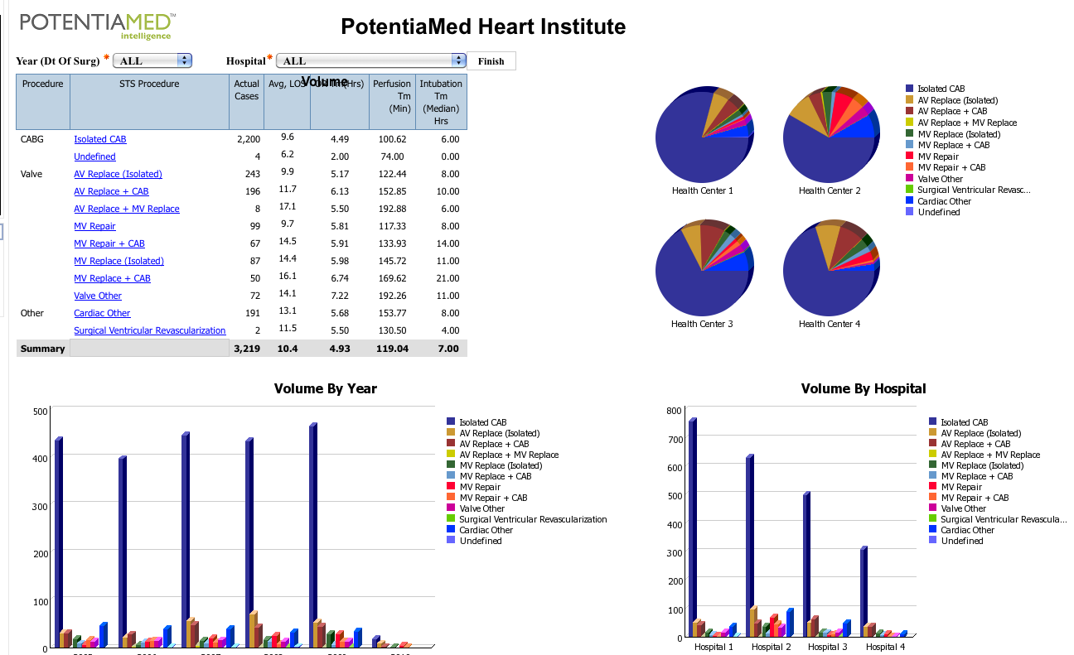
Example Executive Dashboard
PMED
intelligence
Notes:
An example of a hospital dashboard, this from our IBM Global Solutions Center in Dallas, where customers can see Cognos and health analytics solutions within a live demonstration environment

Slide 21
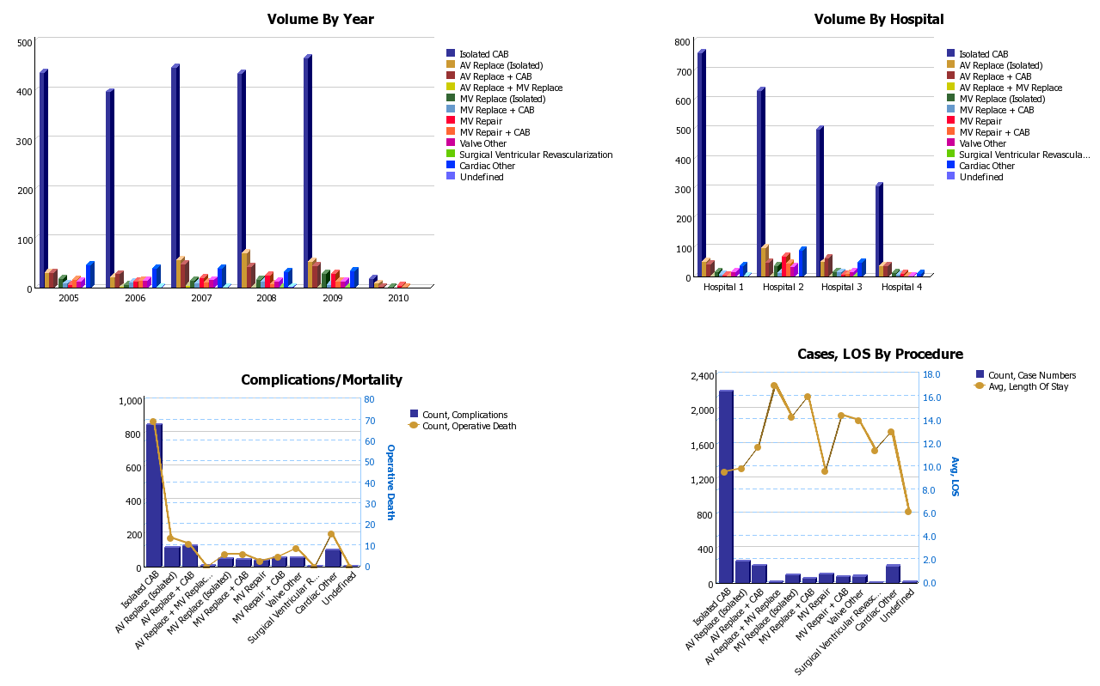
Example Executive Dashboard
PMED
intelligence
Notes:
An example of a hospital dashboard, this from our IBM Global Solutions Center in Dallas, where customers can see Cognos and health analytics solutions within a live demonstration environment

Slide 22
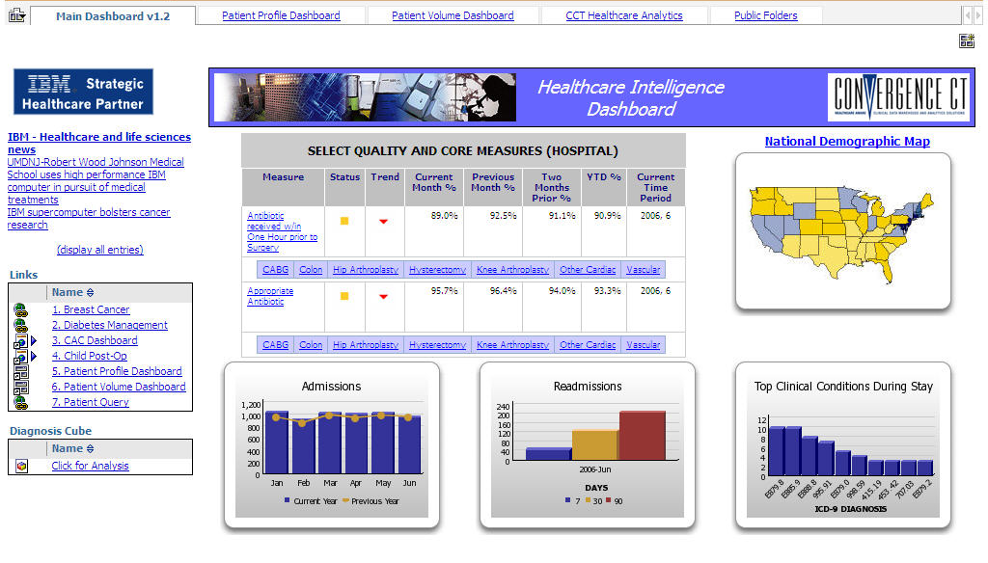
Example Executive Dashboard
PMED
intelligence
Valley Community
Hospital
Notes:
An example of a hospital dashboard, this from our IBM Global Solutions Center in Dallas, where customers can see Cognos and health analytics solutions within a live demonstration environment

Slide 23
Administrative Dashboards
View administrator-level CV service line data
Key Performance Indicators (KPI)
Length of Stay
Blood loss
Intra-operative Blood Product Use
Procedure Optimization
OR Time
Turnover time
Robotic program cost
Robotic per procedure cost etc.
Capacity
System use optimization

Slide 24
Example Administrator Dashboards
PMED
intelligence
Notes:
A dashboard showing comparative data by state and average claim costs

Slide 25
Example Administrator Dashboards
PMED
intelligence
Notes:
A dashboard showing comparative data by state and average claim costs

Slide 26
Surgeon Dashboards
View surgeon-level data
Key Performance Indicators
Length of Stay
Blood loss
Intra-operative Blood Product Use
Procedure Optimization
OR Time / Crossclamp time
Turnover time
Robotic program cost
Robotic per procedure cost etc.
Robotic capacity
System use optimization
Identify trends in:
Performance and outcomes
Referring physician profiles
Demographics by referring physician
Patient average length of stay
Highest and lowest volume referring physicians
Patient risk categories by referring physician
Etc.
Transition from reactive to proactive manager using predictive analytics

Slide 27
Example Surgeon Dashboard
PMED
intelligence
Notes:
STS Data Push

Slide 28
Example Surgeon Dashboard
PMED
intelligence
Notes:
STS Data Push

Slide 29
Trend Analysis
PMED
intelligence
Notes:
This example from a health plan perspective shows scorecard of competing network of providers and cost trends for major diseases

Slide 30
Let’s Get Started!
We look forward to partnering with you to build your successful robotics program.

Slide 31
Disclaimer
Legal Disclaimer: The information in this presentation contains forecasts and predictions whose accuracy cannot be and is not guaranteed, and such information has not been audited. Information has been gathered and compiled from many sources, and neither MIS nor PotentiaMED shall assume responsibility for any errors or inaccuracies in information presented or third party data. No promises or covenants are hereby made or shall be implied with respect to accuracy, results, facts, or otherwise. Reliance on any information contained in this presentation is done at the party's own risk, and both MIS and PotentiaMED disclaim all liability and warranties to the maximum extent permitted by law.

